Slide 1

Stock Price Forecasting Using Machine and Deep learning
Supervised by Dr/ Diaa Salama
& Dr/ Donia Mostafa
Done by
Team Leader: Ahmed AbdelRahman
Ahmed Mohamed Adel
Adham Said
Bassel AbdelRahim

Slide 2
Outlines
Introduction
Data Sets
Preprocessing Data
Models
Results
Conclusion

Slide 3
Introduction
Identify the most reliable model for prediction.
Impact of ML and DL:
Transformed the field
Leverage historical data for more accurate predictions
Evaluation Metrics:
Accuracy
Mean Squared Error (MSE)
Mean Absolute Error (MAE)
Explore how ML and DL techniques enhance stock price forecasting

Slide 4
Data Sets
We have three data sets:
1. Netflix Stock
2. yahoo_Stock
3. Google_Stock_Price
The "Date" attribute serves as the primary temporal reference for the data
"Open“, "High“, "Low“, and "Close" represent the opening, highest, lowest, and closing prices of the stock, respectively, during the trading day.
The "Volume" attribute represents the total trading volume of the stock for the day.

Slide 5
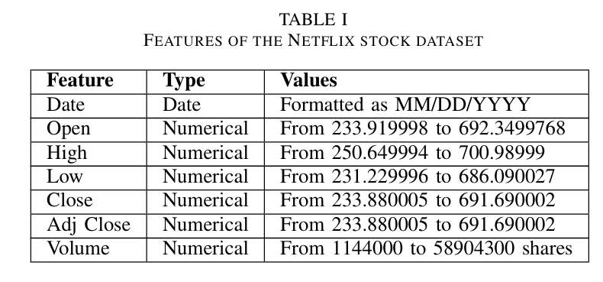
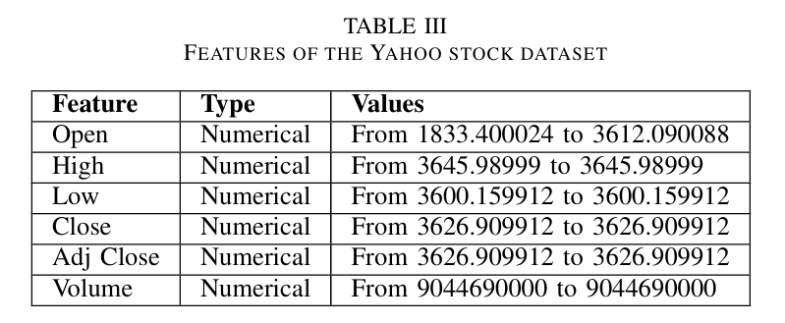
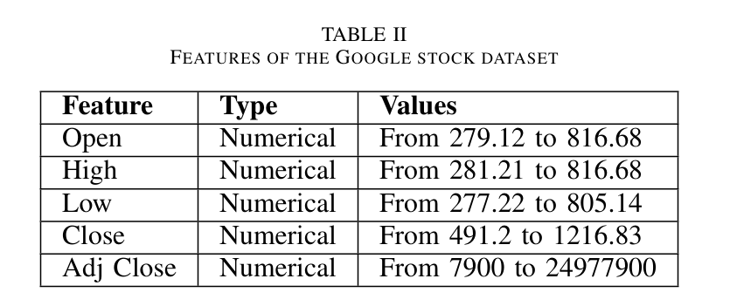
Data Information
All the data are numerical

Slide 6
Data Preprocessing
Converting index “date” to date_time.
Checking for missing values.
Measuring correlation between features and each other and the target.
Creating lag and window features such as: creating three features that are the closing price but shifted backwards, ratio between closing and opening prices, creating a column that computes the rolling mean of the close price for every 30 days
Creating a column that measures the ratio between the rolling mean and the closing price to detect any days in which the closing price was high.

Slide 7
Data Preprocessing
Checking for outliers and removing the extreme outliers from volume column.
Applying standard scaler due to the presence of outliers

Slide 8
Models
We Used 5 Models for forcasting:
Linear Regression using Weighted Moving Average (WMA)
Ridge Regression
Autoregressive Integrated Moving Average (ARIMA)
Extreme Gradient Boosting (XGB)
Gradient Boosting

Slide 9
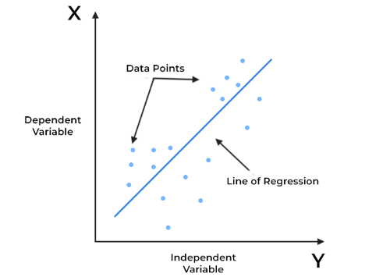
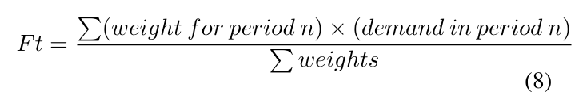
Linear Regression using Weighted Moving Average (WMA)
- LR models the relationship between a dependent variable (target) and one or more independent variables (predictors) by fitting a linear equation to observed data.
- WMA process involves assigning varying weights to data points within a moving average calculation.
- This method is utilized to smooth a realized time series and identify short-term, long-term trends, and seasonal components effectively.

Slide 10
Ridge Regression
It's like a correction tool for features that have strong influences, making our predictions more accurate.
In our analysis, it consistently demonstrated the highest accuracies across all three datasets, showcasing its effectiveness in improving predictive performance.
Helps prevent overfitting in linear regression by shrinking large coefficients.

Slide 11
Autoregressive Integrated Moving Average (ARIMA)
It is a powerful and widely used statistical method for analyzing and forecasting time series data.
Autoregression (AR), involves using the dependent relationship between an observation and a number of lagged observations.
Differencing (I), is used to make the time series stationary, which means that its statistical properties like mean, and variance are constant over time.
Moving Average (MA), the moving average component models the error of the model as a linear combination of error terms from past observations.

Slide 12
Extreme Gradient Boosting (XGB)
Is an advanced machine learning algorithm based on the gradient boosting framework.
It is designed to be highly efficient, flexible, and portable, making it a popular choice for both regression and classification tasks.
The key concepts behind XGBoost revolve around boosting, an ensemble technique that combines the predictions of multiple weak learners (typically decision trees) to create a strong predictive model.

Slide 13
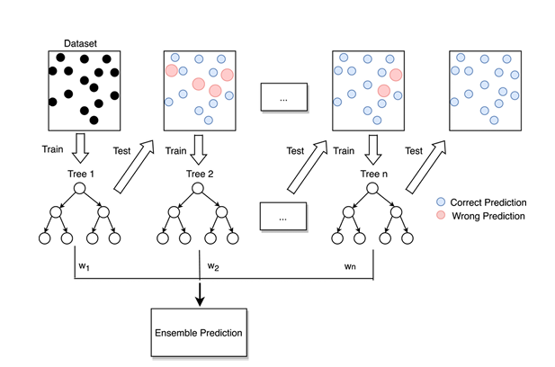
Gradient Boosting
Is an ensemble method that instead of fitting a single model to the data set, it creates more than one model most commonly decision trees.
Where each model tries to improve the results of the previous model by focusing on correctly predicting the errors, until a final optimized model is reached.
Pros: High predictive accuracy due to the sequential correction of errors.
Flexibility to use different loss functions and weak learners
Cons: Can be prone to overfitting, especially with a large number of iterations.
Computationally intensive and time-consuming.

Slide 14
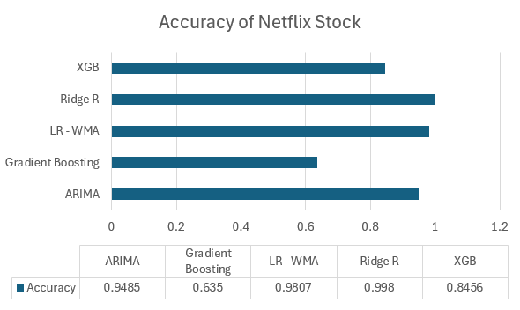
Results Netflix Stock
We found in the 1st data set that; Ridge Regression has the highest accuracy with 99.8%.

Slide 15
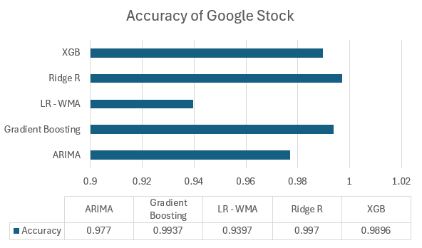
Results Google Stock
Also, we found in the 2nd data set that; Ridge Regression has the highest accuracy with 99.7%.

Slide 16
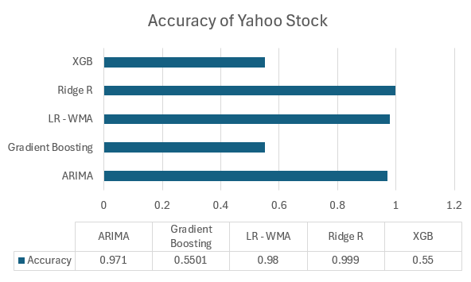
Results Yahoo Stock
Again, in the 3rd data set we found that Ridge Regression has the highest accuracy with 99.9%.

Slide 17
Conclusion
After studying the results, we found that the Ridge Regression Model dominates the accuracies in the three data sets.
With average accuracy 99.8%
So, Ridge Regression is the best model from the 5 models in Stock Price Forecasting

Slide 18
Thank You For Listening

